Slide 1
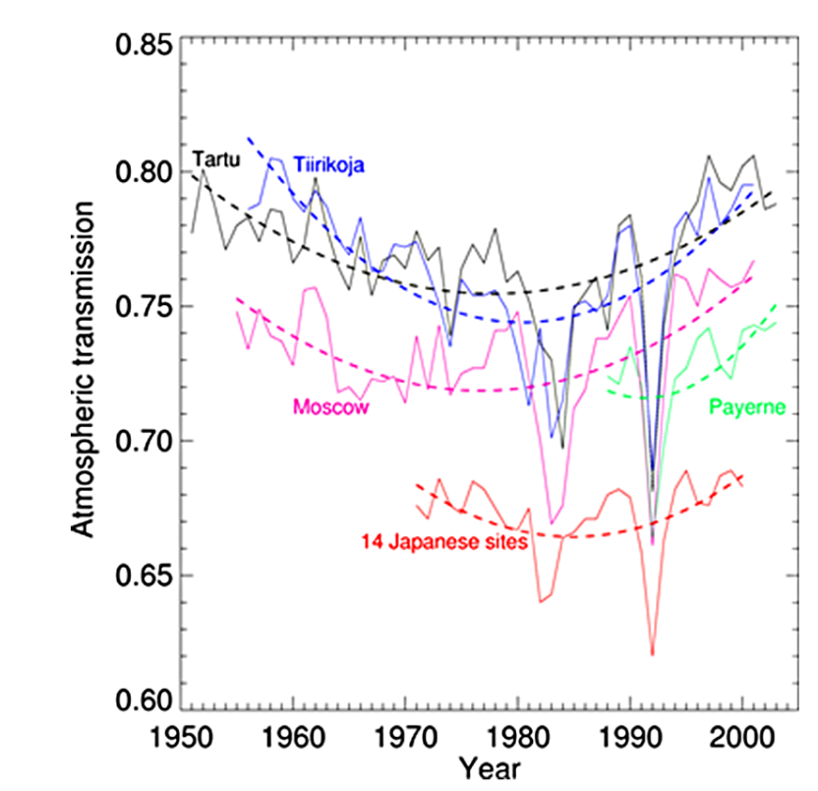
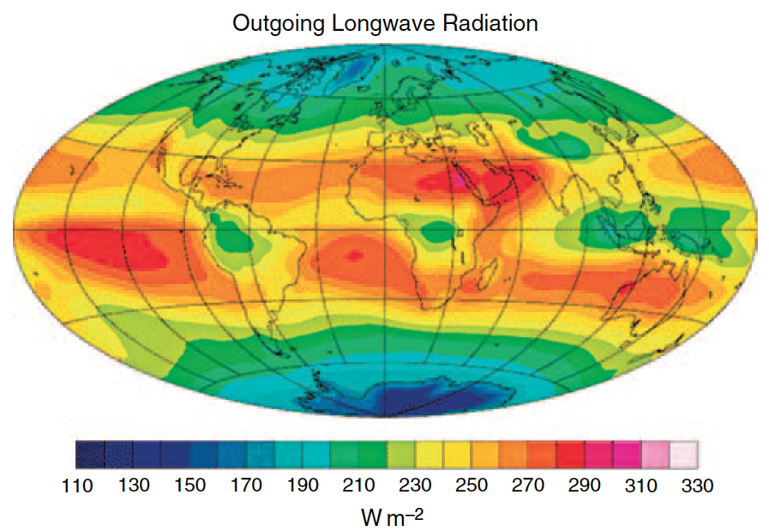

Recap of lecture on 2 October 2025
Air pollution has led to a global dimming effect, masking the greenhouse effect
High clouds warm the atmosphere.
Overall clouds cool.
For each 1°C temperature increase, the atmosphere can hold 7 % more water vapor. Clausius-Clapeyron equation.
$$\frac{∆e_{s}}{e_{s}}=\frac{L_{v}}{T^{ }R_{v}}∗\frac{∆T}{T} ≈20\frac{∆T}{T}$$

